Slide 1
YOU’RE RIGHT:
THIS SUCKS.
Bettering our InfoSec Community by Leaving our InfoSec Community CypherCon 2016
Johnny Xmas & Lesley Carhart

Slide 2
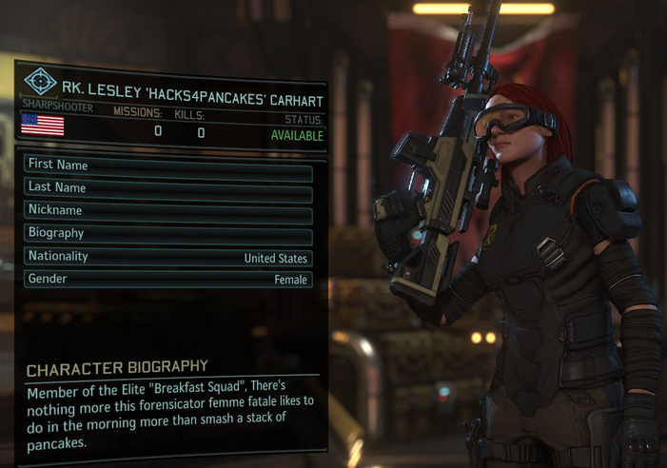
Who is Lesley?
Blue Team / Incident Response and Digital Forensics
I do stuff.
Hack stuff.
Write stuff.
Shoot paper.
Fight people, occasionally with swords.
Pick locks and lock accessories.
Annoy people on the internet [prolifically].
Swift on Security doesn’t hate me [currently].
Justin Bieber probably hates me.
Go Air Force! Rah Rah, etc, etc

Slide 3
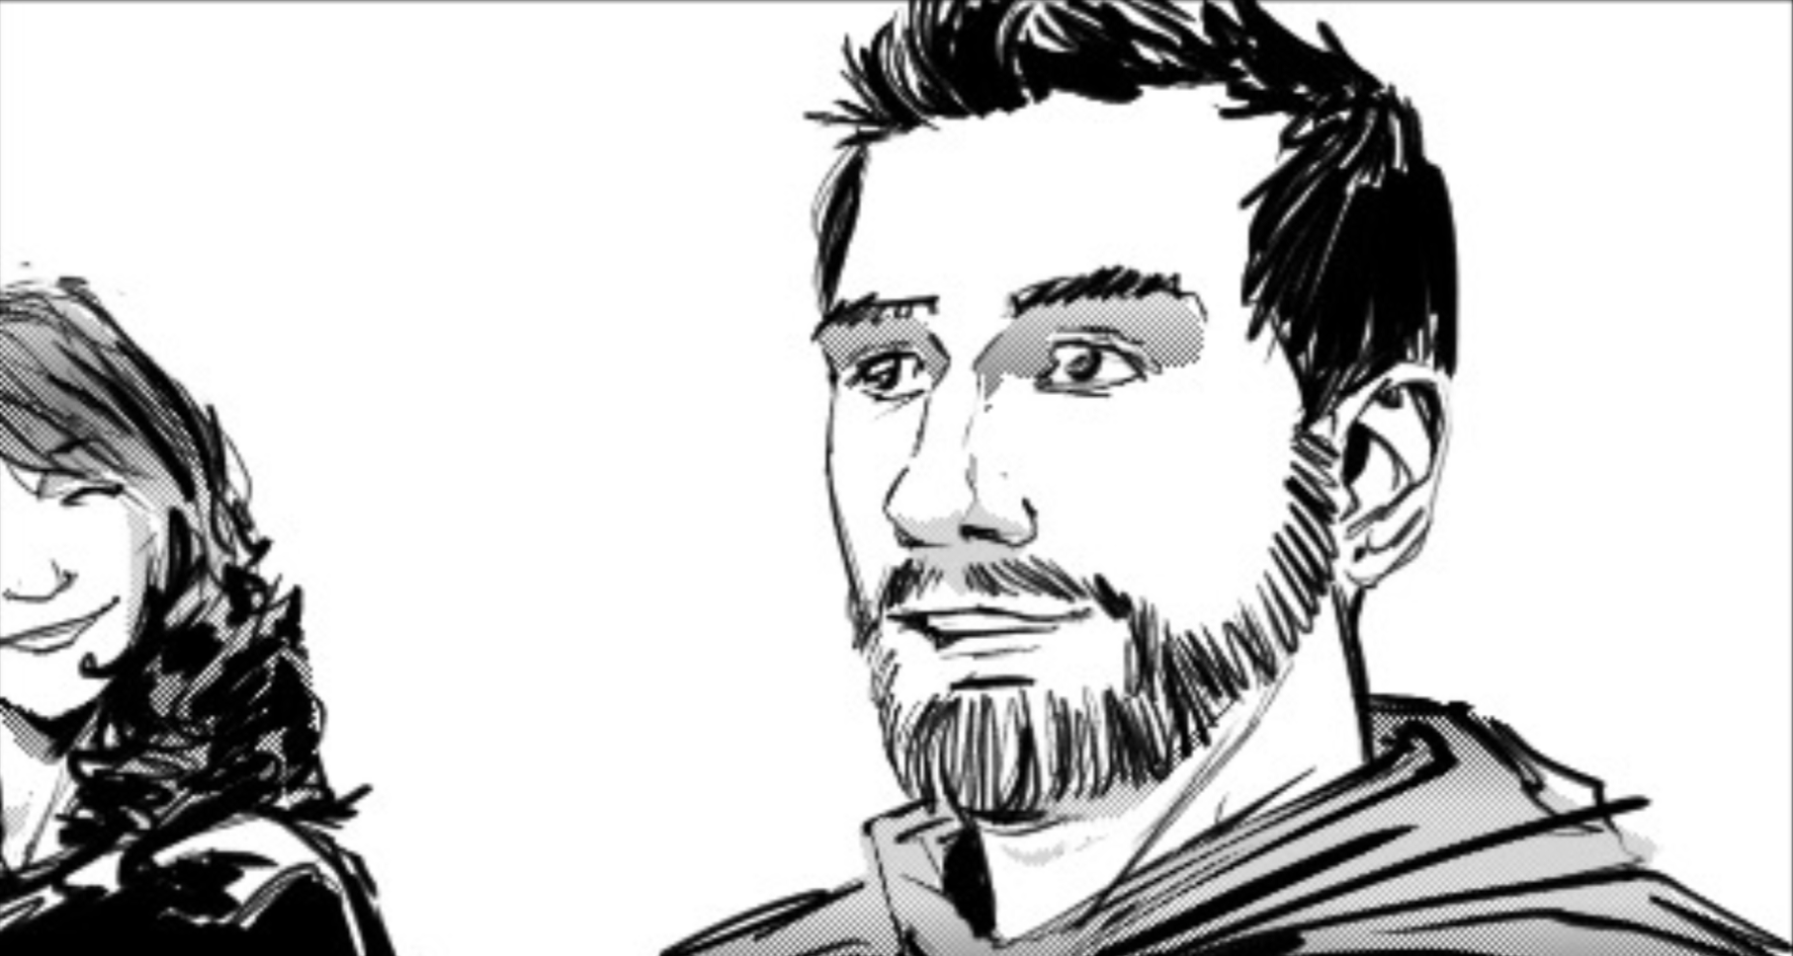
Who is Johnny?
Red Team / Penetration Testing | Social Engineering
Not even my final form!
TSA Keys Guy
Hardware Hacker
Musician
Pharmacologist
Practicing Mystic
Tweeter (To the extent that it’s worth mentioning)
Swift on Security RT’s me
Justin Bieber probably doesn’t know who I am

Slide 4
The InfoSec Echo Chamber (is a problem)
We are all aware of the problems.
Nobody outside our community is fully aware of the problems.
Media ignores some problems, gets others wrong & invents the rest.
Stigmas and our perceived image (to others and ourselves) are a problem.
We’re not willing to leave our comfort zone, and that’s a problem, too.

Slide 5
Why the Echo Chamber Sucks
We’re not recruiting from a broad pool of the best potential candidates.
We’re allowing the media to tell our story (wrong) for us.
We’re allowing vendors who market irresponsibly and without technical merit to gain a market foothold.
We’re not pushing politicians and the public to tackle problems that matter.

Slide 6
Super-Awesome Benefits of Breaking out of the Echo Chamber
Travel to exciting places, meet new people, and recruit them.
See security from other perspectives.
Demonstrate to the world that we are not Chris Hemsworth.
Demonstrate to the world that we are Chris Hemsworth.

Slide 7
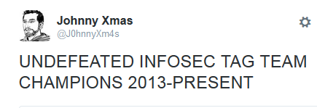
So, We Proudly Introduce:

Slide 8
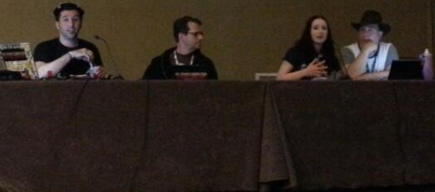
Lesley and Johnny’s [awkward and] super exciting adventures in trying to teach random people everybody about infosec.
*and get them to come work for us, immediately.

Slide 9
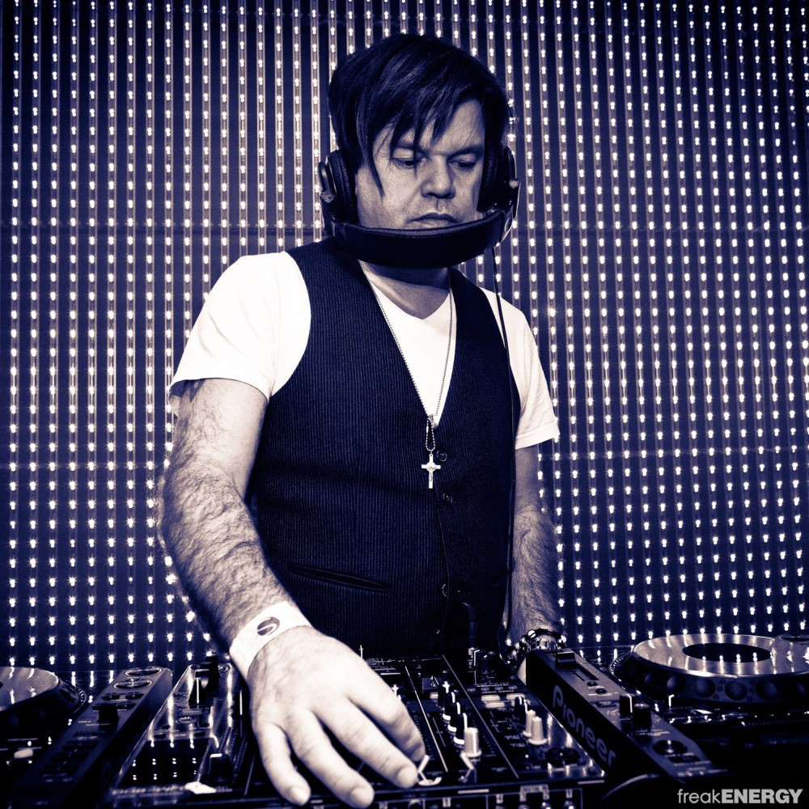
Our Adventures Include:
Career Advising and Mentoring
Infosec Resume Advising and Editing
Explaining Super Technical Things to Non-Technical People
Hanging out with Paul Oakenfold
Speaking at Anime/Gaming/ SciFi Cons (with cosplay)
Starting InfoSec Meetups
Blogging
Dealing with the Media

Slide 10

YOU CAN DO THIS TOO!

Slide 11
Building Social Interaction Skills
Johnny is an introverted agorophobe.
We know. Wearing Pants Sucks.
Between Netflix, PS4, and our bookshelves, we have an amazing home safety bubble
(that’s incredibly difficult to leave!)
You will NOT succeed at first. You must PRACTICE, PRACTICE, PRACTICE
Practice EFFECTIVELY!
. . . Just watch Johnny’s talks.

Slide 12
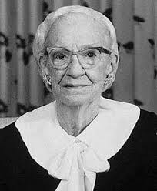
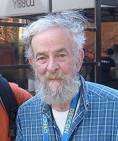

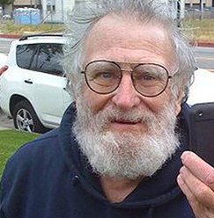
Explaining Super Technical Things to Non-Technical People
Making Assumptions is Dangerous!
Lawyers
The Media
People Younger and Older than you
Don’t be condescending.
Practice!
Robert Morris
Adm. Grace Hopper
Lyndsey Scott
John Draper

Slide 13
Career Advising and Mentoring
People need our help!
Drop the elitism! (We need people.)
Not everybody had/has the same advantages.
Not everybody has the same interests, backgrounds, or frame of reference.
Seek mentees out.

Slide 14
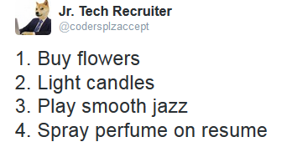
InfoSec Resume Advising and Editing
Resumes are key to breaking into infosec
We as resume recipients \ hiring managers should offer feedback to candidates and mentees.
People still use obsolete resume formats.
If they use a “format” at all.
People aren’t seeking out resume editing.
People are not properly leveraging keywords and quantification to make it through automated filtering and HR.

Slide 15
Recruiting at InfoSec Cons
“InfoSec is everybody’s job!”
InfoSec is fun & sexy!
Everybody is some kind of ‘geek’.
Other geekdom cons & venues are surprisingly receptive!
Present things in an interactive way and draw people in.
They’re already excited; DON’T RUIN THAT!

Slide 16

Start Your Own Meetup!
Live in an “IT Hotspot,” but have no meetups? Make your own!
Neutral, non-elitist environment.
Welcome non-InfoSec attendees.
Stick with it! Word of mouth spreads slowly.
Avoid pushy salespeople / vendors.
Don’t charge dues / fees.
Don’t require presentations / 0Days.

Slide 17
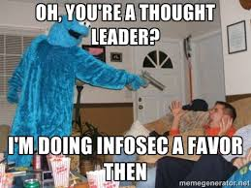
Blogging & Podcasting
You have important things to say that people want to hear about.
Don’t worry if it’s been said before!
It’s an awesome way to learn and grow yourself.
Don’t worry about being a “thought leader” or page visits.
Collaborate with other bloggers and podcasters - help the community!

Slide 18
Dealing with the Media
Carefully vet members of the media who contact you.
Provide reasoned responses without irrational biases. (NO FUD!)
Ask for the questions prior to interviews.
Leverage employer and community PR and legal specialists as necessary.
Call out poor journalism. Stand up and say something!

Slide 19
Breakout Organizations
Hackers For Charity
www.hackersforcharity.org
I am the Cavalry www.iamthecavalry.org
Electronic Frontier Foundation www.eff.org

Slide 20

Questions, Comments, Taunts?
Johnny Xmas - @J0hnnyXm4s
Lesley Carhart - @hacks4pancakes

